Slide 1
PowerShell From The Trenches - Workflows ...Of Course Yes!
Fast track hands on Powershell Worflows
Jorge Besada, DBA, Carnival Cruise Line

Slide 2


Slide 3
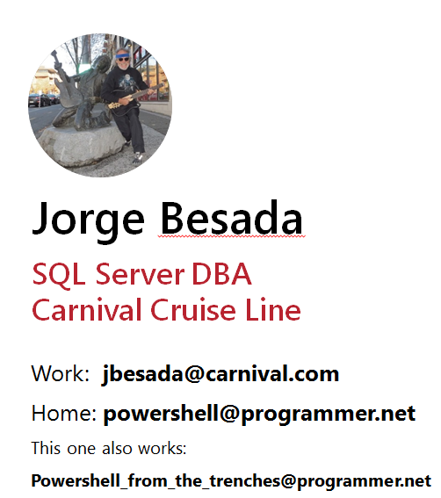
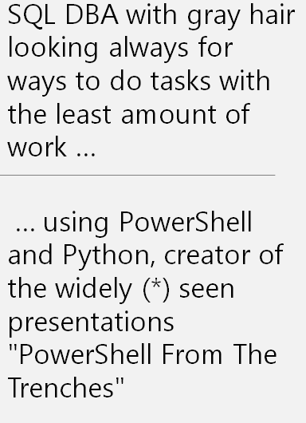

Slide 4
This is the plan
1) WorkFlow – what are they? – the book definition
2) The Hello World workflow program
3) A sample program using jobs
4) A sample program using workflows
5) Jobs program – the workflow version
Goodie

Slide 5
WorkFlow – what is it – book definition
Windows PowerShell workflows are designed for scenarios
where these attributes are required:
* Long-running activities.
* Repeatable activities.
* Frequently executed activities.
* Running activities in parallel across one or more machines.
* Interruptible activities that can be stopped and re-started, which includes surviving a reboot of the system against which the workflow is executing.

Slide 6
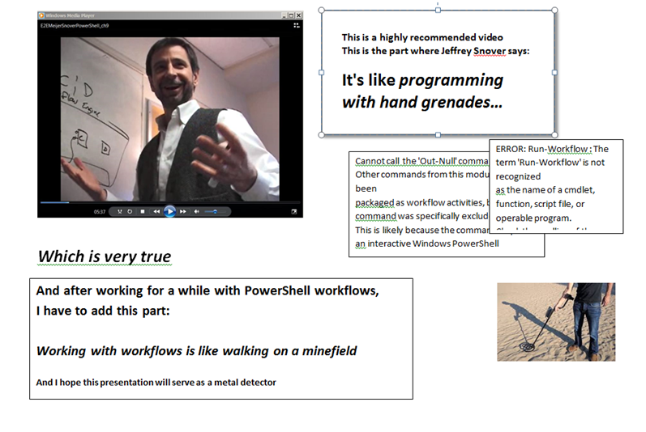

Slide 7
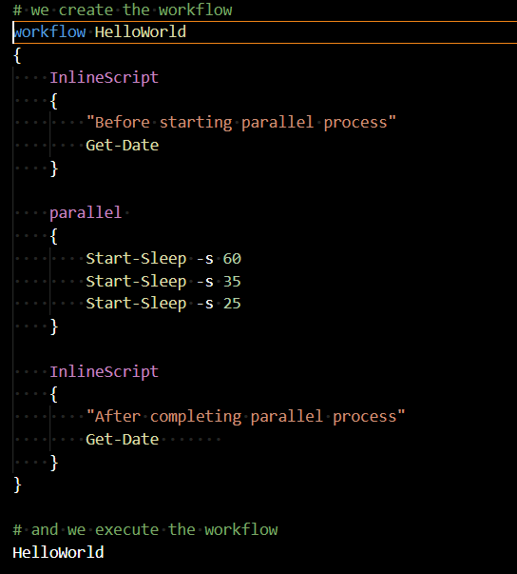
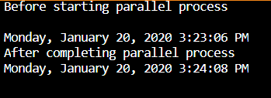
Sample workflow , my HelloWorld version
Take home lessons:
Yes, workflows work as expected:
The total time is the longest of the three “programs”
You define a workflow like a function, and call it
The InlineScripts are your friend

Slide 8
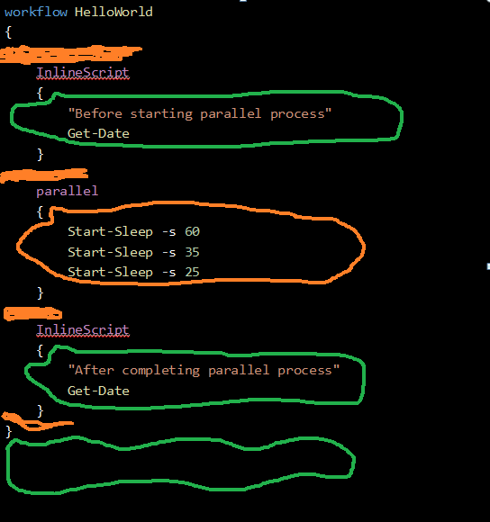
First Things First - Scope and Visibility Green – powershell business as usual area Orange: workflow rules apply
workflow HelloWorld
{
InlineScript
{
"Before starting parallel process"
Get-Date
}
parallel
{
Start-Sleep -s 60
Start-Sleep -s 35
Start-Sleep -s 25
}
InlineScript
{
"After completing parallel process"
Get-Date
}
}

Slide 9
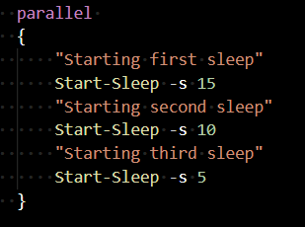


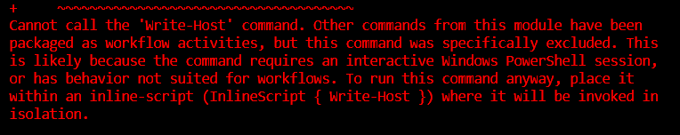

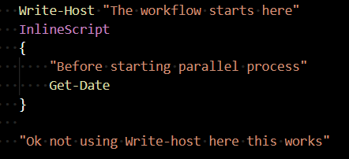
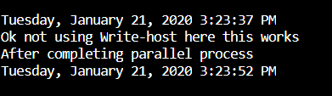
Get used to weird things
This is nice
This is naughty
So these are the suggestions:
In case of errors: use InlineScript when possible
In case of doubt: use InlineScript
When inside Workflow: the error messages are quite detailed ☺, learn from them

Slide 10
Good to know you can return stuff from the InlineScript
Good to know
you can pass stuff to the InlineScript
FROM THE BOOK
InlineScript Variables
By default, the variables that are defined in a workflow aren't visible to the commands in the InlineScript script block. To make workflow variables visible to the InlineScript, use the $Using scope modifier. The $Using scope modifier is required only once for each variable in the InlineScript.
Returning variables in InlineScript
InlineScript commands can change the value of the variable that was imported from workflow scope, but the changes aren't visible in workflow scope. To make them visible, return the changed value to the workflow scope
Notes:
Let’s see in the next slides this passing and receiving stuff to and from inlinescripts

Slide 11
InlineScript : pass and receive values
workflow HelloWorld
{
"This will used as parameter in below inlinescript"
$p1 = "a|b|c|d|e"
$p1
# This DOES NOT WORK - InlineScript is not a Script Block:
# InlineScript ($p1) orInlineScript { param ($p1) ... }
"--------------------------------------------------------"
InlineScript #Showing use of a parameter (AKA external value)
{
# DON'T DO THIS (in case you did not read above note): param($using:p1)
"received a parameter"
$using:p1
"doing something to it"
$r1 = ($using:p1).Split('|')
$r1
}
"--------------------------------------------------------"
$retval = InlineScript #Showing how to return something from the inlinescript
{
$s1 = "some internal value generated within"
return $s1
}
" A return value:"
$retval
"--------------------------------------------------------"
$retval2 = InlineScript #Combining both: use parameter, return value
{
"received a parameter"
$using:p1
"doing something to it"
$r1 = ($using:p1).Split('|')
return $r1
}
"Return value:"
$retval2
InlineScript
{
"After completing parallel process"
Get-Date
}
}
HelloWorld # and we execute the workflow
Notes:
We can pass values to InlineScripts, just remember the $using

Slide 12
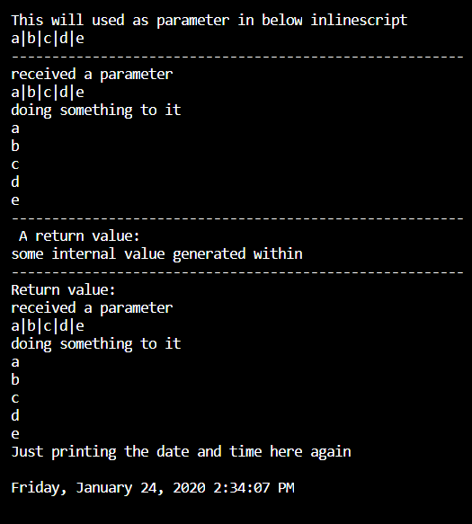
And here we see the output
Notes:
Ok now we just need to add a little thing before we continue

Slide 13
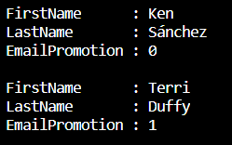
Functions in powershell work fine …
# Script_Blocks_are_a_good_thing_A.ps1
# using a function
function Invoke-Sqlcmd3_db ($ServerInstance,$Query, $Database)
# Based on Chad Millers Invoke-Sqlcmd3
{
$QueryTimeout=600
$conn=new-object System.Data.SqlClient.SQLConnection
$constring = "Server=" + $ServerInstance + ";Trusted_Connection=True;database=" + $Database
$conn.ConnectionString=$constring
$conn.Open()
if($conn)
{
$cmd=new-object System.Data.SqlClient.SqlCommand($Query,$conn)
$cmd.CommandTimeout=$QueryTimeout
$ds=New-Object System.Data.DataSet
$ds
$da=New-Object System.Data.SqlClient.SqlDataAdapter($cmd)
[void]$da.fill($ds)
$conn.Close()
$ds.Tables[0]
}
}
#Sample use:
$server = "WORKSTATION\Sqlexpress"
$database = "AdventureWorks2017"
$query = 'select top 5 [FirstName],[LastName],[EmailPromotion] from Person.Person'
$r = Invoke-Sqlcmd3_db $server $query $database
$r
Notes:
Yes they work fine but get in the habit of using script blocks for everything for workflows

Slide 14
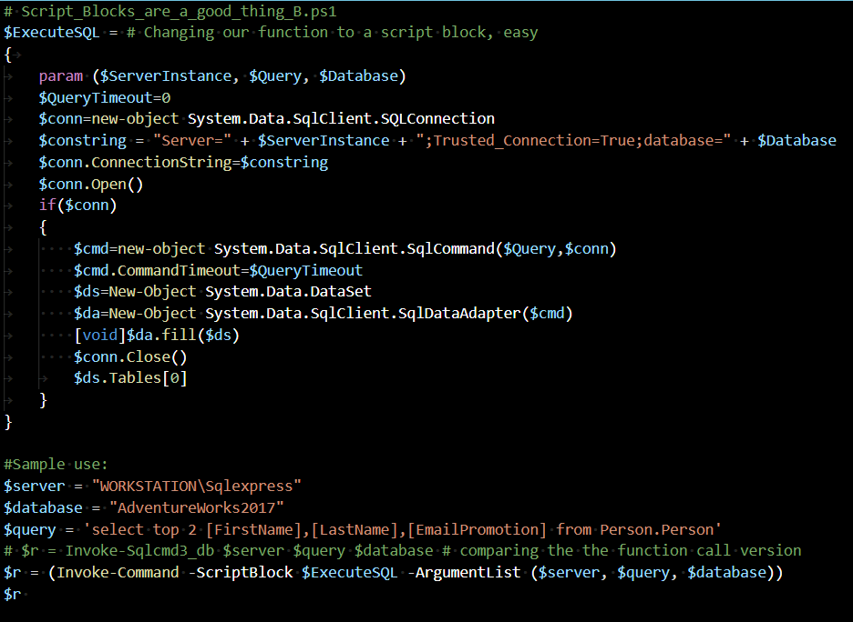
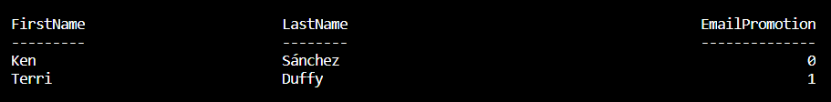
Script Blocks are better friends in workflows
Notes:
Good practice for the workflower: use script blocks and save yourself aggravations

Slide 15
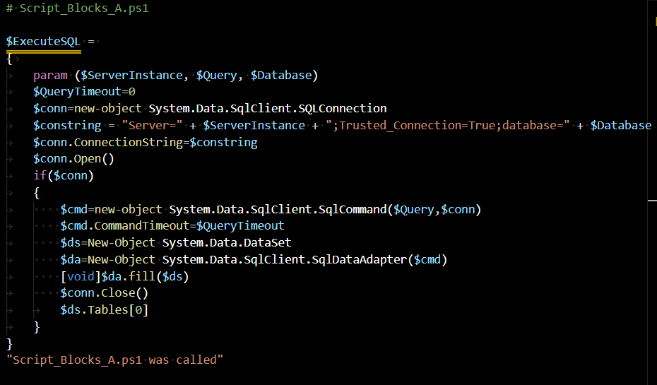
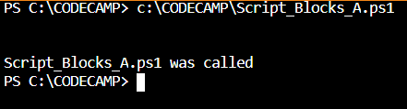
Notes on scope and organizing the code
Notes:
Sample module containing a single script block – no execution, just checking

Slide 16
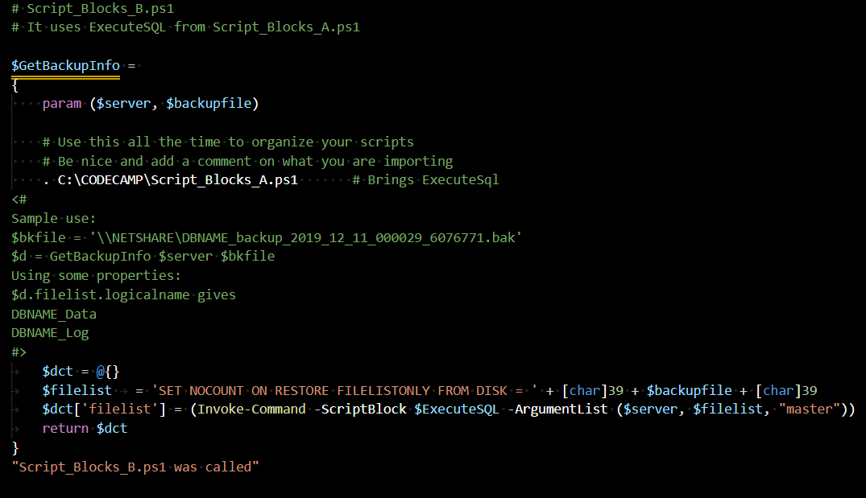
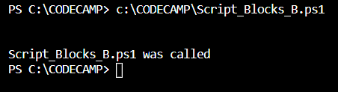
We can import code using the dot and the file name
Nothing is being done yet.
Notes:
Same as before, just creating the script block, not executing it

Slide 17
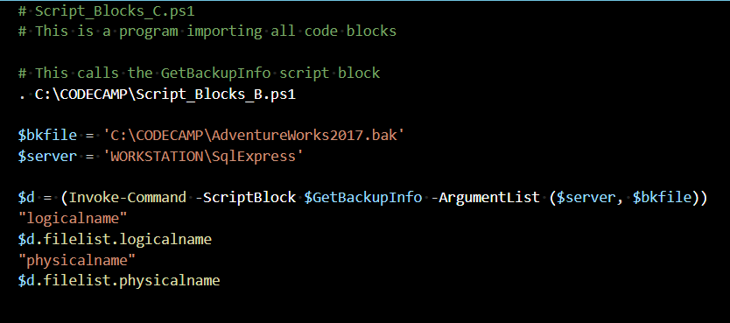
Showing calls for the script blocks from a main program
Script_Blocks_B.ps1 was called
logicalname
AdventureWorks2008R2_Data
AdventureWorks2008R2_Log
physicalname
C:\CODECAMP\AdventureWorks2017.mdf
C:\CODECAMP\AdventureWorks2017_log.LDF
PS C:\CODECAMPMP>
Notes:
Here we are using the script block import in a main program

Slide 18
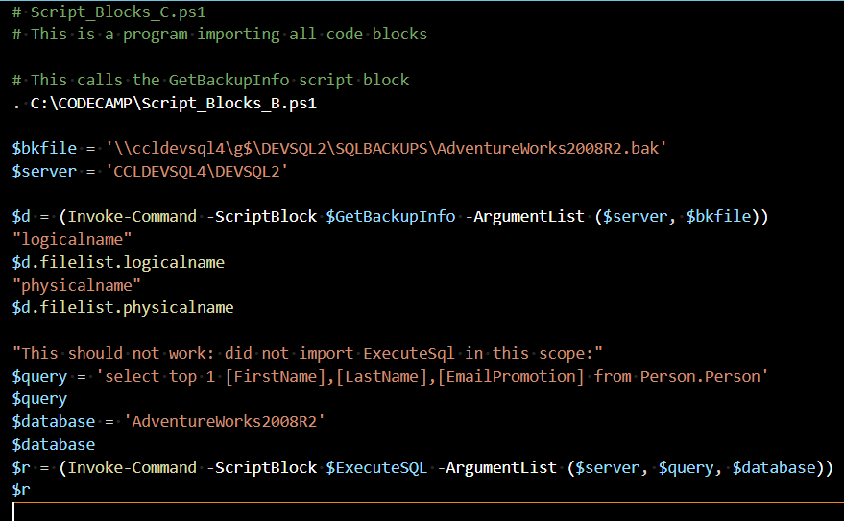
Checking the import process and the usual suspects
Notes:
Note to selves: this does not happen running the code in the Visual Studio Code editor, it caches the ExecuteSQL code and the code does not err. ALWAYS TEST USING a cmd window and batch file and powershell script, don’t be lazy

Slide 19
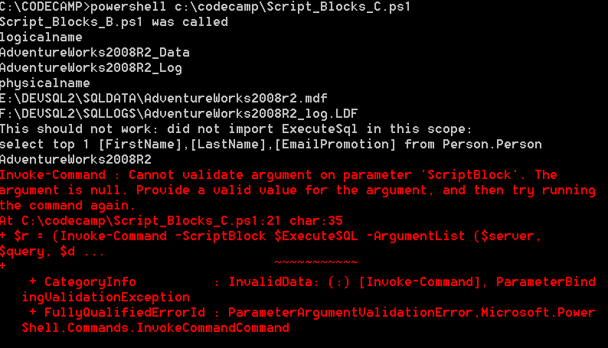
What happens if you do not import and you do a real test Create a cmd file to call your powershell script Run it from a cmd window
Notes:
Doing the test the right way, confirmed the expectation of the error, all is well. And the wrong way is to test from your editor, you may find that code is cached and what should not work … worked

Slide 20
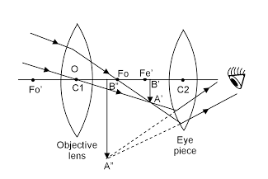


Intermezzo
Visibility is important in the code morass
May the Eye of Ra help you see better
Use script blocks all the time in your support programs
Use InlineScript most of the time in your workflow programs
Always test your program using a cmd file calling your PowerShell script (avoid surprises from your nice favorite editor)
Don’t reinvent the wheel: follow the PowerShell mantra
Steal from the Best
And Create the Rest
And you will be enlightened
Notes:
Ok we have covered the basics, some reminders here of good practices

Slide 21
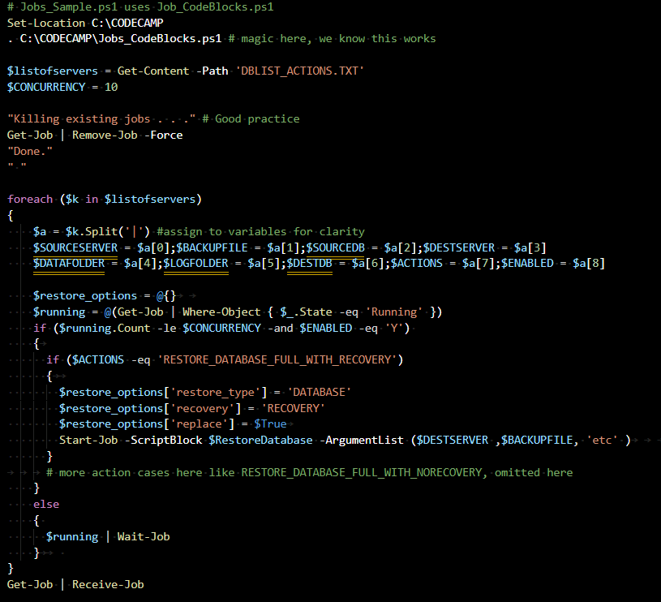


Sample program using jobs
DBLIST_ACTIONS.txt source has a line for each entry with this format
SOURCESERVER|BACKUPFILE|SOURCEDB|DESTSERVER|DATAFOLDER|LOGFOLDER|DESTDB|ACTIONS|ENABLED
Jobs in one slide
Notes:
This is a classic jobs program, using script blocks to manage the code, it works well.

Slide 22
Output of jobs program
Killing existing jobs . . .
Done.
Id Name PSJobTypeName State HasMoreData Location
-- ---- ------------- ----- ----------- --------
1 Job1 BackgroundJob Running True localhost
1 Job1 BackgroundJob Completed True localhost
3 Job3 BackgroundJob Running True localhost
5 Job5 BackgroundJob Running True localhost
7 Job7 BackgroundJob Running True localhost
3 Job3 BackgroundJob Completed True localhost
5 Job5 BackgroundJob Completed True localhost
7 Job7 BackgroundJob Completed True localhost
Restoring from file
\\SQLBACKUPS\SQLBackupUser\ZZZ_Deleteme_1_backup2.bak
USE MASTER RESTORE DATABASE [ZZZ_Deleteme_1] FROM DISK ='\\SQLBACKUPS\SQLBackupUser\ZZZ_Deleteme_1_backup2.bak' WITH MOVE 'ZZZ_Deleteme_1' TO 'E:\DEVSQL2\SQLDATA\ZZZ_Deleteme_1_Data.mdf', MOVE 'ZZZ_Deleteme_1_log' TO 'F:\DEVSQL2\SQLLOGS\ZZZ_Deleteme_1_Log.ldf', NOUNLOAD, RECOVERY, STATS = 10, REPLACE;
ALTER AUTHORIZATION ON DATABASE::[ZZZ_Deleteme_1] TO [sa]
Latest backup from folder
\\SQLBACKUPS\SQLBackupUser\ZZZ_Deleteme_1_backup2.bak
USE MASTER RESTORE DATABASE [ZZZ_Deleteme_2] FROM DISK ='\\SQLBACKUPS\SQLBackupUser\ZZZ_Deleteme_1_backup2.bak' WITH MOVE 'ZZZ_Deleteme_1' TO 'E:\DEVSQL2\SQLDATA\ZZZ_Deleteme_2_Data.mdf', MOVE 'ZZZ_Deleteme_1_log' TO 'F:\DEVSQL2\SQLLOGS\ZZZ_Deleteme_2_Log.ldf', NOUNLOAD, RECOVERY, STATS = 10, REPLACE;
ALTER AUTHORIZATION ON DATABASE::[ZZZ_Deleteme_2] TO [sa]
Latest backup from folder
\\SQLBACKUPS\SQLBackupUser\ZZZ_Deleteme_1_backup2.bak
USE MASTER RESTORE DATABASE [ZZZ_Deleteme_3] FROM DISK ='\\SQLBACKUPS\SQLBackupUser\ZZZ_Deleteme_1_backup2.bak' WITH MOVE 'ZZZ_Deleteme_1' TO 'E:\DEVSQL2\SQLDATA\ZZZ_Deleteme_3_Data.mdf', MOVE 'ZZZ_Deleteme_1_log' TO 'F:\DEVSQL2\SQLLOGS\ZZZ_Deleteme_3_Log.ldf', NOUNLOAD, RECOVERY, STATS = 10, REPLACE;
ALTER AUTHORIZATION ON DATABASE::[ZZZ_Deleteme_3] TO [sa]
Latest backup from folder
\\SQLBACKUPS\SQLBackupUser\ZZZ_Deleteme_1_backup2.bak
USE MASTER RESTORE DATABASE [ZZZ_Deleteme_4] FROM DISK ='\\SQLBACKUPS\SQLBackupUser\ZZZ_Deleteme_1_backup2.bak' WITH MOVE 'ZZZ_Deleteme_1' TO 'E:\DEVSQL2\SQLDATA\ZZZ_Deleteme_4_Data.mdf', MOVE 'ZZZ_Deleteme_1_log' TO 'F:\DEVSQL2\SQLLOGS\ZZZ_Deleteme_4_Log.ldf', NOUNLOAD, NORECOVERY, STATS = 10, REPLACE;
DECLARE @kill varchar(8000) = ''; SELECT @kill = @kill + 'kill ' + CONVERT(varchar(5), spid) + ';' FROM master..sysprocesses WHERE dbid = db_id('ZZZ_Deleteme_4') EXEC(@kill);
Notes:
Several copies of a ZZZ_Deleteme database were restored with different names, one of them left not recovered , which in later runs was used to apply transaction logs (not shown here)

Slide 23
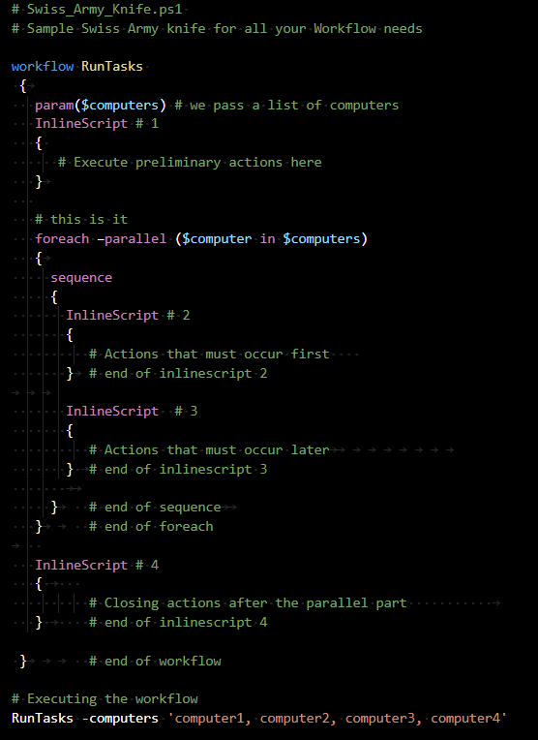

The Swiss Army Knife of the Workflows
It does everything (*)
You can:
pass parameters
insert actions before
use the magic of the
foreach -parallel
insert actions after
(*) ok, almost everything
Notes:
Save this model and use it everywhere, don’t leave home without it, in many cases you will not need the sequence part, but sometimes it comes handy to deal with the order of actions in parallel process, will see in the next slide

Slide 24
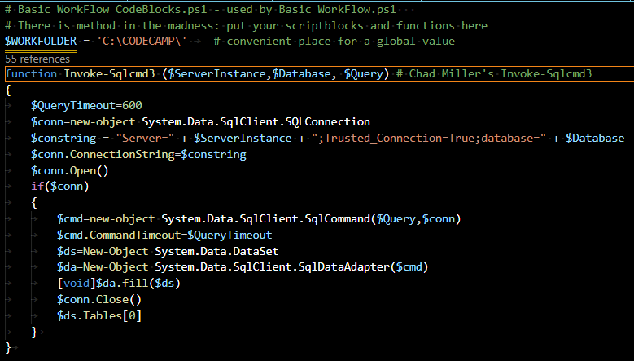
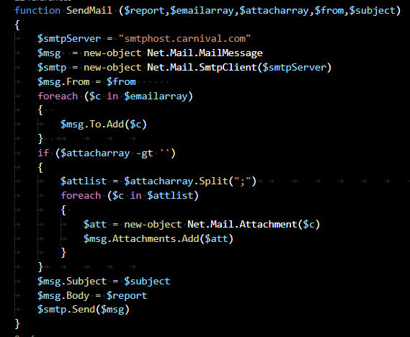
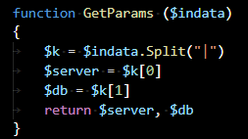
Preparing conditions for our first workflow
Here is the Basic_Workflow_CodeBlocks.ps1
where we store all the support functions
Notes:
Will create a program that will get data from several servers and databases, saves data in files, compresses them and emails a report

Slide 25
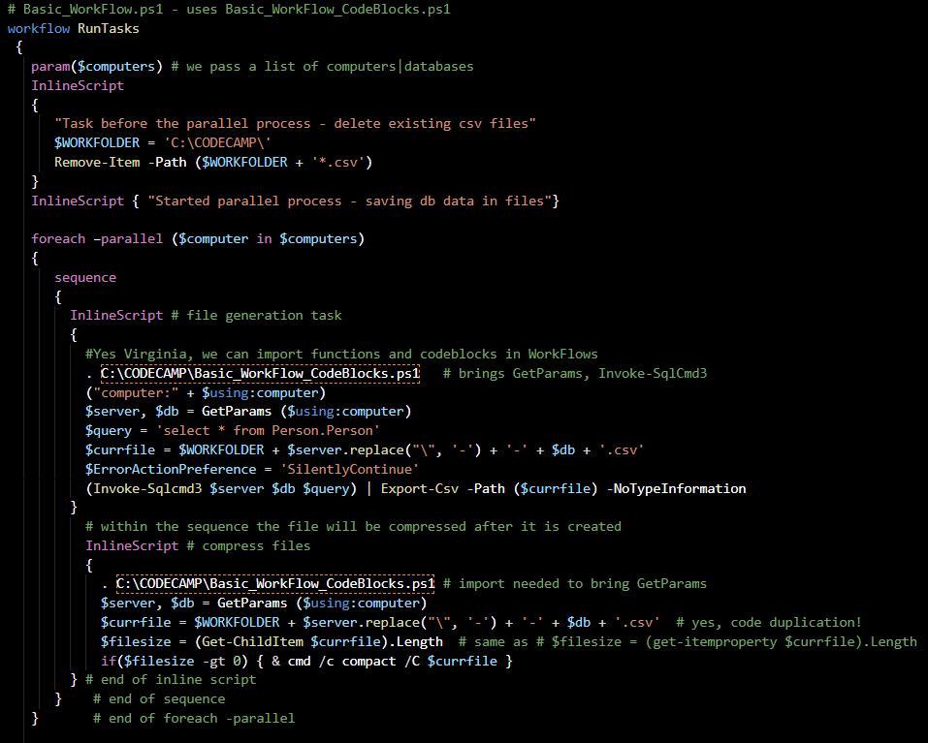
Our first workflow program , first screen
Notes:
Showing this in two screens, for ease of viewing: workflow is defined, a list of values passed to it, and for each list value actions are applied – getting files from database and compressing them

Slide 26
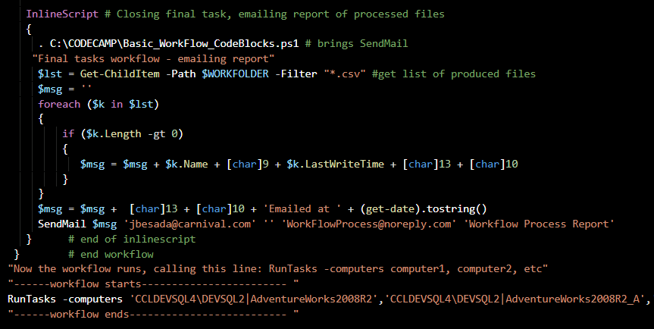
Our first workflow program , second screen
We change into C:\CODECAMP, where we have our cmd file Basic_Work.cmd
, which looks like this
powershell C:\CODECAMP\Basic_Workflow.ps1 > C:\CODECAMP\Basic_Workflow.out
and we execute it ...
Notes:
And after the parallel section of the program an email report is created, and the workflow executed

Slide 27
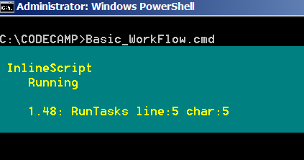
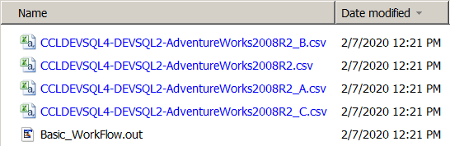
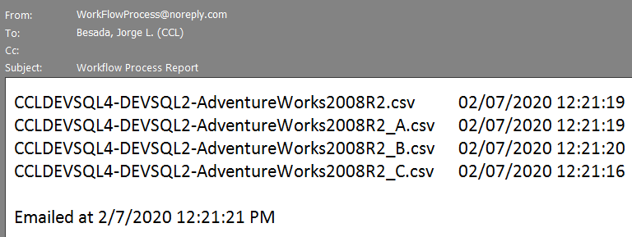
And here we see the output produced, chatty output helps the newbie
Now the workflow runs, calling this line: RunTasks -computers computer1, computer2, etc
------workflow starts------------------------
Task before the parallel process - delete existing csv files
Started parallel process - saving db data in files
computer:CCLDEVSQL4\DEVSQL2|AdventureWorks2008R2_C
computer:CCLDEVSQL4\DEVSQL2|AdventureWorks2008R2_B
computer:CCLDEVSQL4\DEVSQL2|AdventureWorks2008R2_A
computer:CCLDEVSQL4\DEVSQL2|AdventureWorks2008R2
Compressing files in C:\CODECAMP\
CCLDEVSQL4-DEVSQL2-AdventureWorks2008R2_C.csv 13884824 : 5206016 = 2.7 to 1 [OK]
1 files within 1 directories were compressed.
13,884,824 total bytes of data are stored in 5,206,016 bytes.
The compression ratio is 2.7 to 1.
Compressing files in C:\CODECAMP\
Compressing files in C:\CODECAMP\
CCLDEVSQL4-DEVSQL2-AdventureWorks2008R2_B.csv 13884824 : 5206016 = 2.7 to 1 [OK]
1 files within 1 directories were compressed.
13,884,824 total bytes of data are stored in 5,206,016 bytes.
The compression ratio is 2.7 to 1.
CCLDEVSQL4-DEVSQL2-AdventureWorks2008R2_A.csv 13884824 : 5206016 = 2.7 to 1 [OK]
1 files within 1 directories were compressed.
13,884,824 total bytes of data are stored in 5,206,016 bytes.
The compression ratio is 2.7 to 1.
Compressing files in C:\CODECAMP\
CCLDEVSQL4-DEVSQL2-AdventureWorks2008R2.csv 13884824 : 5206016 = 2.7 to 1 [OK]
1 files within 1 directories were compressed.
13,884,824 total bytes of data are stored in 5,206,016 bytes.
The compression ratio is 2.7 to 1.
Final tasks workflow - emailing report
------workflow ends--------------------------
Notes:
No surprises, worked as expected

Slide 28
Now we are ready, let’s “worflowize” the jobs program

